Slide 1
Semantic Web 3W: What, Where, Why?
Oleksandr Krakovetskyi
Software Engineer at The Frayman Group
MCP, Microsoft Regional Director
Microsoft PDC10, Vinnitsya

Slide 2
Agenda
Semantic Web 3W
Semantic Web Cloud
Semantic Web Application Architecture

Slide 3
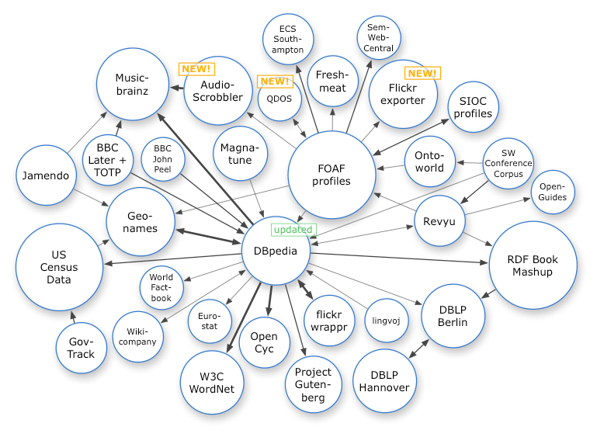
Semantic Web Cloud (2008)

Slide 4
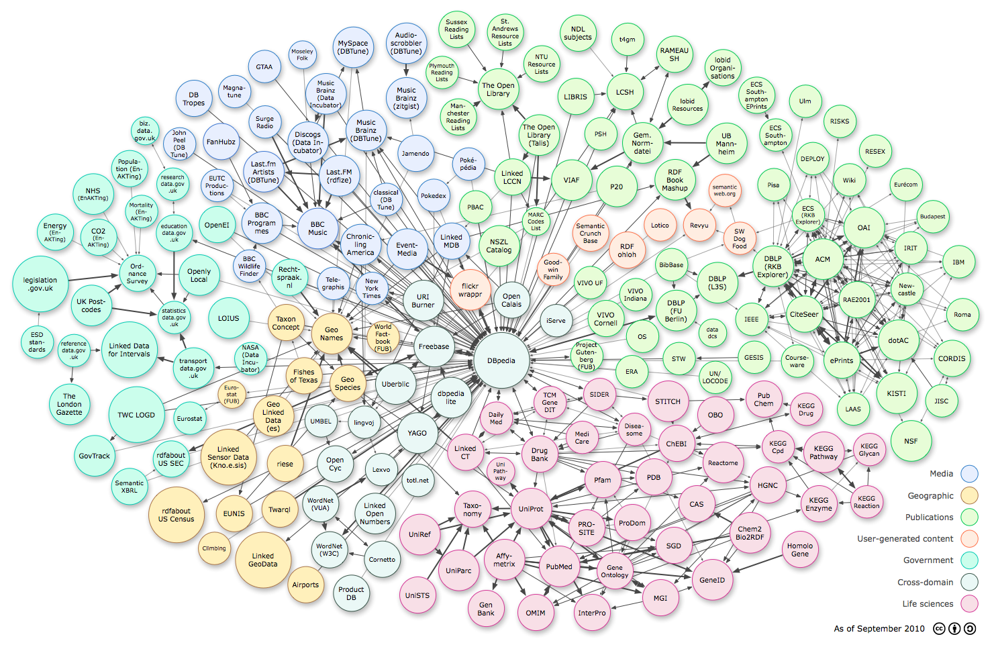
Semantic Web Cloud (2010)
http://richard.cyganiak.de/2007/10/lod/lod-datasets_2010-09-22_colored.png

Slide 5
Semantic Web Resources
DBpedia - a dataset containing extracted data from Wikipedia; it contains about 2.18 million concepts described by 218 million triples, including abstracts in 11 different languages (see the very DBpedia resource associated to the present wikipedia page)
DBLP Bibliography - provides bibliographic information about scientific papers; it contains about 800,000 articles, 400,000 authors, and approx. 15 million triples
GeoNames provides RDF descriptions of more than 6,500,000 geographical features worldwide.
Revyu - a Review service consumes and publishes Linked Data, primarily from DBpedia.
riese - serving statistical data about 500 million Europeans (the first linked dataset deployed with XHTML+RDFa)
UMBEL - a lightweight reference structure of 20,000 subject concept classes and their relationships derived from OpenCyc, which can act as binding classes to external data; also has links to 1.5 million named entities from DBpedia and YAGO
Sensorpedia - A scientific initiative at Oak Ridge National Laboratory using a RESTful web architecture to link to sensor data and related sensing systems.
FOAF - a dataset describing persons, their properties and relationships
OpenPSI for the OpenPSI project a community effort to create UK government linked data service that supports research
VIAF (Virtual International Authority File) - an aggregation of authority files (author names) from national libraries from around the world.

Slide 6
Semantic Web Resources
Dbpedia
OpenCalais
New York Times
TechCrunk
IEEE
IMDB

Slide 7
Semantic Web Tools
RDF / SPARQL
Linq 2 RDF
dotNetRDF
SemWeb.NET

Slide 8
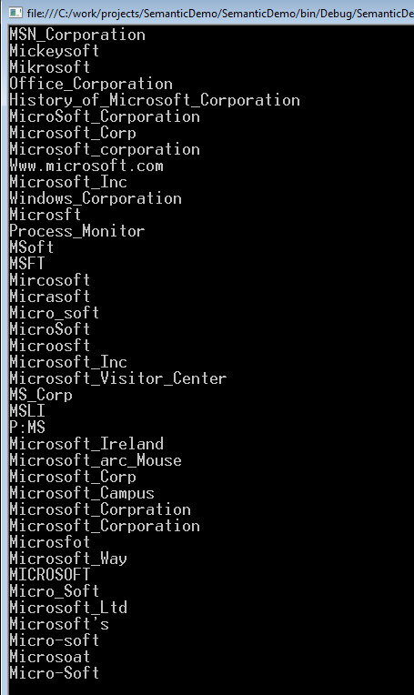
Example / MSFT Aliases
//Define a remote endpoint
//Use the DBPedia SPARQL endpoint with the default Graph set to DBPedia
SparqlRemoteEndpoint endpoint = new SparqlRemoteEndpoint(new Uri("http://dbpedia.org/sparql"), "http://dbpedia.org");
//Make a SELECT query against the Endpoint
SparqlResultSet results = endpoint.QueryWithResultSet(@"
PREFIX owl: <http://www.w3.org/2002/07/owl#>
PREFIX xsd: <http://www.w3.org/2001/XMLSchema#>
PREFIX rdfs: <http://www.w3.org/2000/01/rdf-schema#>
PREFIX rdf: <http://www.w3.org/1999/02/22-rdf-syntax-ns#>
PREFIX foaf: <http://xmlns.com/foaf/0.1/>
PREFIX dc: <http://purl.org/dc/elements/1.1/>
PREFIX : <http://dbpedia.org/resource/>
PREFIX dbpedia2: <http://dbpedia.org/property/>
PREFIX dbpedia: <http://dbpedia.org/>
PREFIX skos: <http://www.w3.org/2004/02/skos/core#>
SELECT ?property ?hasValue ?isValueOf
WHERE {
{
<http://dbpedia.org/resource/Microsoft> ?property ?hasValue .
}
UNION {
?isValueOf ?property <http://dbpedia.org/resource/Microsoft> .
}
}");
foreach (SparqlResult result in results) {
if (result.Value("property").ToString() == "http://dbpedia.org/property/redirect")
Console.WriteLine(result.Value("isValueOf").ToString().Replace("http://dbpedia.org/resource/", null));
}

Slide 9
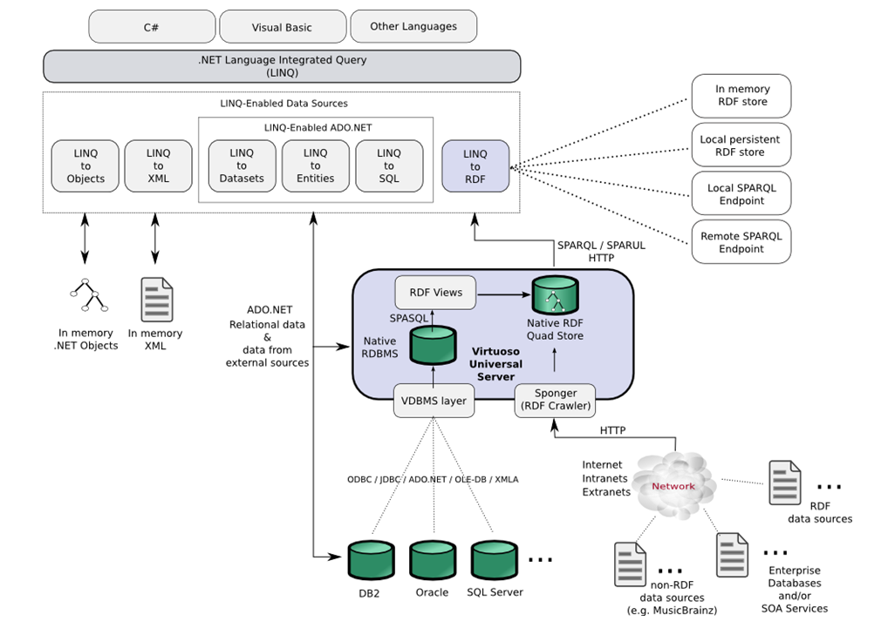
Application Architecture
http://virtuoso.openlinksw.com/whitepapers/rdf%20linked%20data%20dotNET%20LINQ.html

Slide 10
Q&A
akrakovetsky@fraymangroup.com

